Slide 1

T24 Insight Platform
By: kanel.soeng@amkcambodia.com

Slide 2
DAY 1
OBJECTIVE
Understand the business data, how we ask the right question?
Understand the element of every reports
Understand the terminology such as table, matrix, chart, row, columns, keys..
EXERCISES FOR DAY1

Slide 3
What is business need?
What is Data
Lead company : The top key of the data you want to know
Business date: The act of business date you want validate
Branch: The branch run under the company you want to drill down and see
Exploratory Data Analysis & Reporting
Query
Help us to understand what subsets of dataset look like
Statistics
Help us understand the global properties of dataset by using descriptive numberic measures like the mean of an attribute or maximum and minimum value in a column
Visualizations
Help to see the global properties of dataset

Slide 4
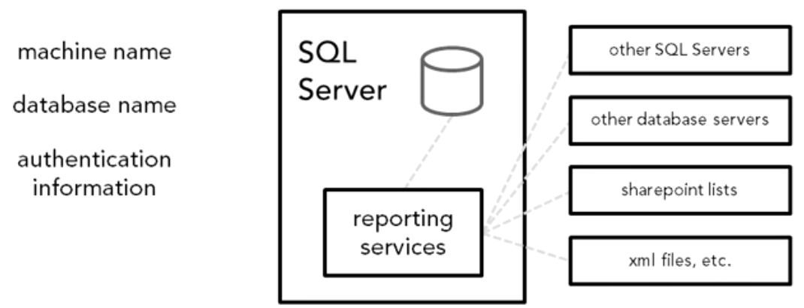
Element of Reports: WHERE>WHAT>HOW?
WHERE?
Where the data you are interested in?
Data Source

Slide 5
Element of Reports: WHERE>WHAT>HOW?
WHAT?
What table?
What row?
What column?
What condition?
What order?
Data set

Slide 6
Element of Reports: WHERE>WHAT>HOW?
Report Layout
HOW?
Font/Color?
Textual or Graphical?
Can view Interact?

Slide 7
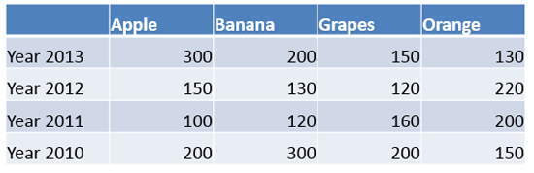
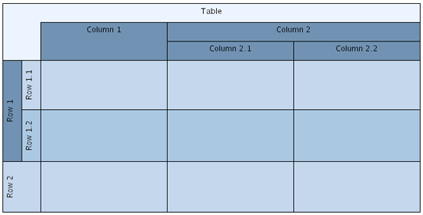
What You Should Know?
Table
Row
Columns
Key
Relationships
SQL basic

Slide 8
EXERCISES FOR DAY1
Problem 1
By follow this phrase “AS A ….. FROM …. I WANT TO SEE THE REPORT OF …… BY…….”
Example: As a Chief Of Credit, from Credit department/team , I want to see the report of New Customer By Branch,
Problem 2
How you explore the date to solving the problem number1
Problem 3
Create you wanted reporting template in the excel.

Slide 9
END OF DAY 1

